Slide 1
History of Computers
CPSC 231:
Intro to Computer Science for
Computer Science Majors I
Fall 2023

Slide 2
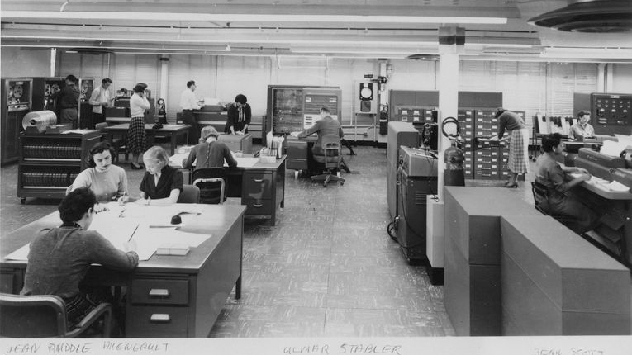
History of Computers

Slide 3
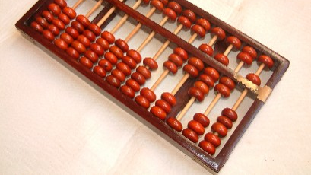
Abacus inv. ~300-400 B.C
This Photo by Unknown Author is licensed under CC BY-SA
Notes:
Abacus is known to be the most ancient calculator or computer device
It was used to perform fundamental arithmetic computations like multiplication, division.
Some countries still use this device to teach basic calculations to school children.
The abacus shows how numbers, letters, and signs can be stored in a binary system on a computer, or via ASCII

Slide 4
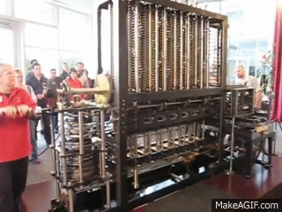
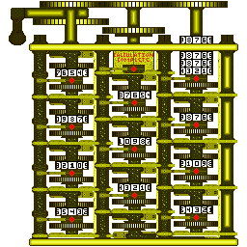
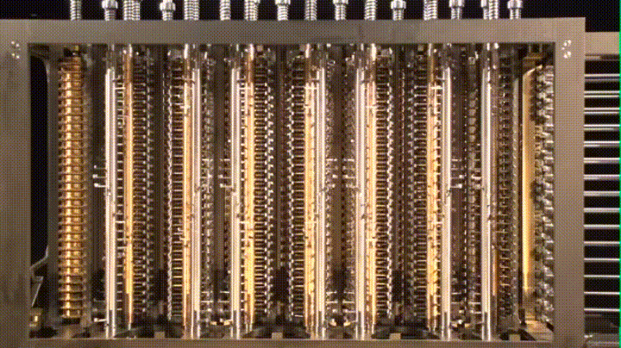
Difference Engine (Charles Babbage)
A difference engine is an automatic mechanical calculator designed to tabulate polynomial functions. (~1822)
A mathematician, philosopher, inventor and mechanical engineer, Babbage originated the concept of a digital programmable computer.
“father of the computer“
In 1991, a functioning difference engine was constructed from Babbage's original plans.
Notes:
This is Charles Babbage’s difference engine. Charles Babbage was an English mathematician who is the first pioneer of computer. Difference engine was an automatic calculating machine that could perform tedious and time-consuming mathematical calculations. It could tabulate the values and also printed them.

Slide 5
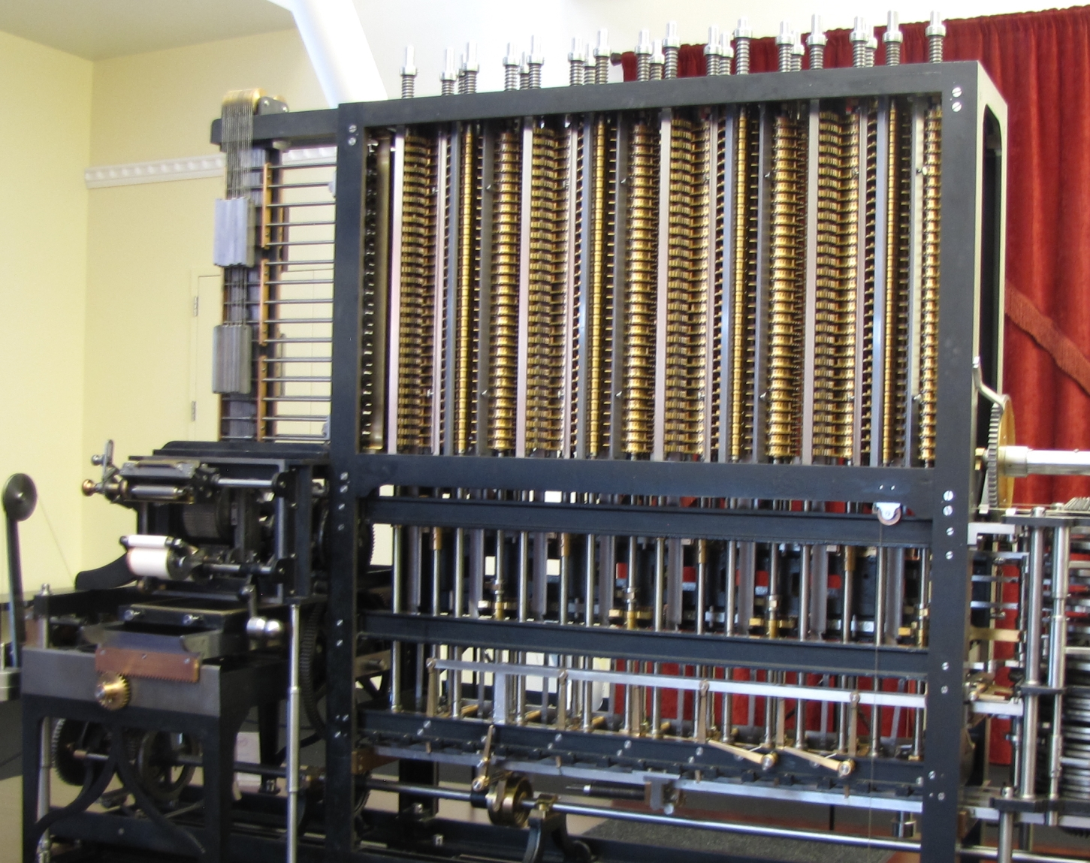
Computers – Difference Engine

Slide 6
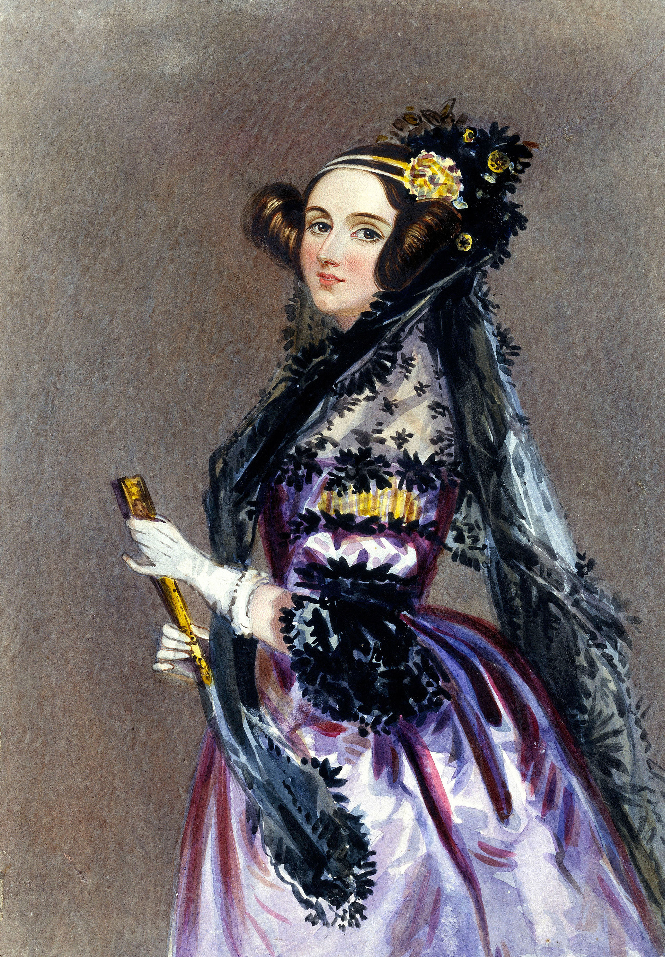
Ada Lovelace (1815 –1852)
Mathematician and writer
Daughter of Lord Byron (*interesting fellow*)
Worked with Charles Babbage
“The first programmer”
Early philosophy of computer science (The effects of technology on people)
This Photo by Unknown Author is licensed under CC BY-SA
Notes:
Ada Lovelace is considered the first computer programmer who worked with Charles Babbage.
She is also considered the first person to recognize that computers had a much larger potential than mathematical calculation

Slide 7

Alan Turing (1912 – 1954)
Father of Computer Science and Artificial Intelligence
Worked at Bletchley Park (broke Nazi encryption code)
Mathematician, logician, computer scientist, philosopher, cryptanalyst
Proposed: Turing Machine, Turing Test
This Photo by Unknown Author is licensed under CC BY-SA
Notes:
He was mathematician, computer scientist, and codebreaker.
He is the father of computer science and AI
He proposed Turing test, originally called the “imitation game” by Alan Turing
It’s a test of machine’s ability to exhibit intelligent behavior equivalent to that of a human.
So in this test, there are typically three participants: a human interrogator, a human respondent, and a machine being tested.
The interrogator’s role is to ask questions, and they do not see or interact with the respondents directly. They communicate through written text.
The objective of the test is for the machine to respond to questions in a way that is indistinguishable from how a human respondent would answer.
In other words, the machine must convince the interrogator that it is human.
If the interrogator cannot consistently distinguish the machine's responses from those of the human, the machine is said to have "passed" the Turing Test.
This turing test is a benchmark for evaluating the linguistic capabilities and NLP abilities of machines, particularly in AI research

Slide 8

Turing Test: Discussion of AI
https://www.youtube.com/watch?v=sXx-PpEBR7k

Slide 9
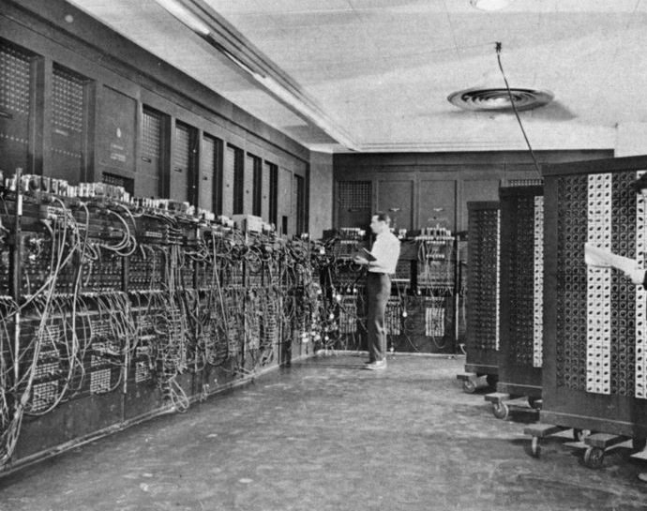
Computers – ENIAC (1945)
The first programmable, electronic, general-purpose digital computer
~ 167 sq meters
Notes:
Stands for “Electronic Numerical Integrator and Computer”. It was the world’s first all electronic general purpose digital computer. ENIAC laid the foundation for the modern digital computers. It was a massive machine that used vacuum tubes for its electronic components, and it was designed to perform a wide range of numerical calculations.
ENIAC has significance since it marked the transition from mechanical calculators to electronic digital computers, setting the stage for the development of modern computers.

Slide 10
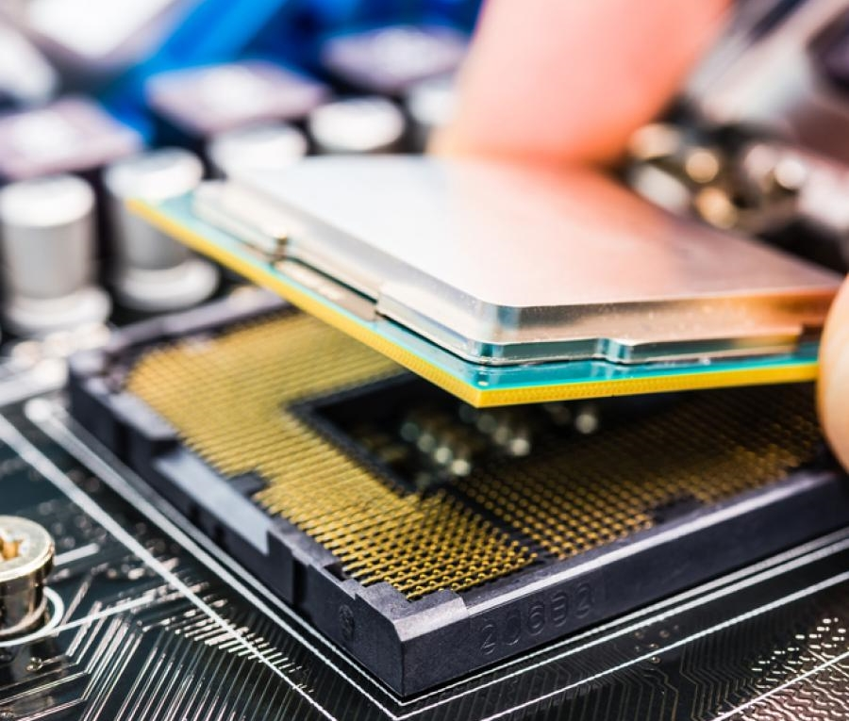
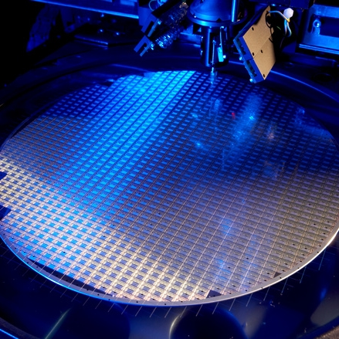
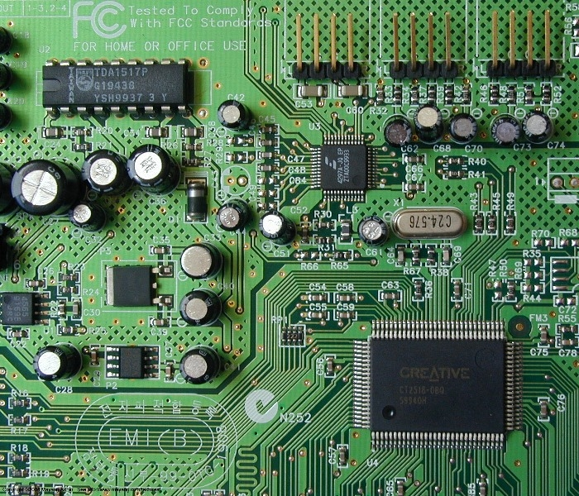
Modern Computers
Integrated Circuits (1959) patent by Robert Noyce. Co-inventor of integrated circuit made of silicon.
William Shockley was the manager of a research group at Bell Labs that included John Bardeen and Walter Brattain.
The three scientists were jointly awarded the 1956 Nobel Prize in Physics for "their researches on semiconductors and their discovery of the transistor effect.“
Considered founder of silicon valley, his company spawned Intel/AMD/National Semi conductors
Notes:
Modern computers are highly advanced electronic devices capable of performing a wide range of tasks and calculations.
These have integrated circuits often referred to as chips, are critical components in modern computers.
So we know about CPU, GPU, memory chips such as RAM, these are basically ICs.

Slide 11
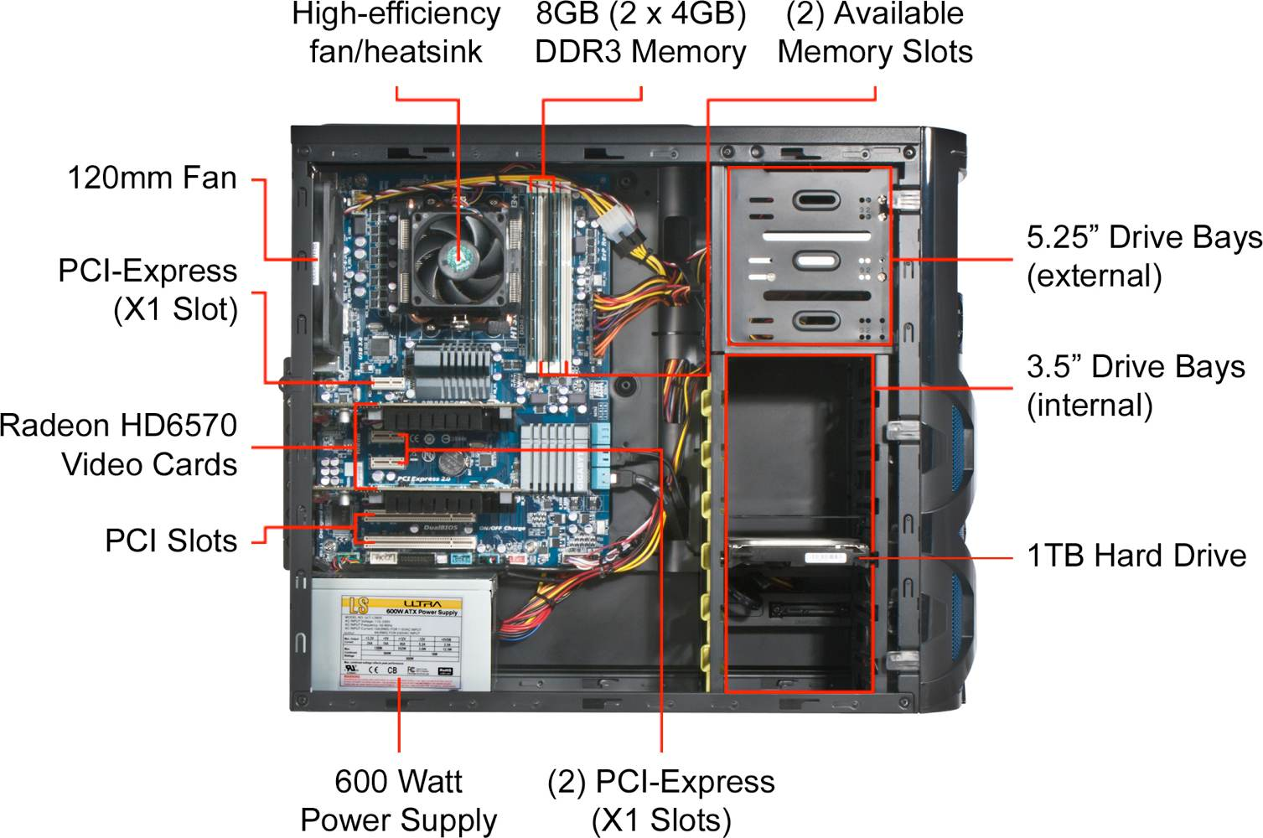
Modern Computers
Notes:
So this is an image of a casing of a modern computer where we can see the motherboard with different slots for hard drive, memory, GPU, and so on.
PCI express is a high-speed interface standard used for connecting various hardware components to the motherboard. These PCIe slots are on motherboard are used for connecting devices like GPU, network card, and more.
Drive bays are slots or compartments in a computer case or chassis designed to hold various storage devices, typically hard drives and solid-state drives.

Slide 12
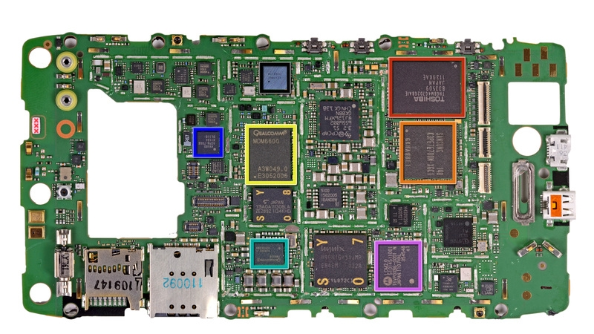
Modern Computers

Slide 13
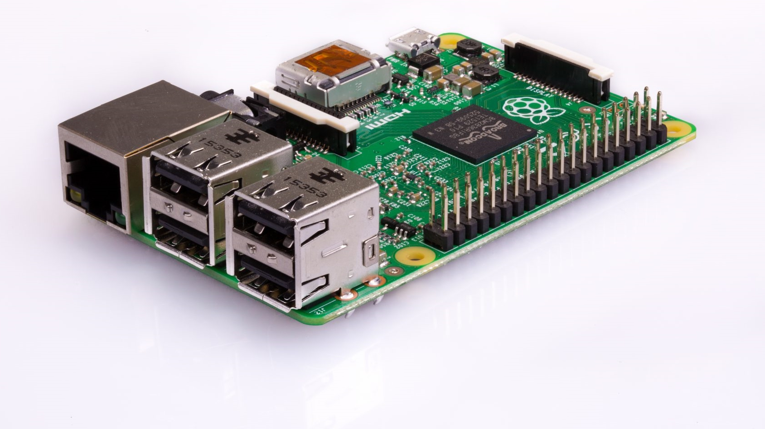
Modern Computers

Slide 14
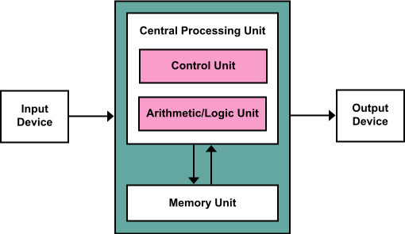
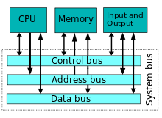
John von Neumann
Mathematician and Physicist
Modern CPUs are based off of Von Neumann (Princeton) Architectures (1945)
Program instructions are data just like data processed by program
Control Unit tracks current step of program in memory
Stored-program architecture (versus ENIAC types where you’d input program my physical configuration steps)
Notes:
John von Neumann played important role in the development of modern computers. He is known for the concept of John von Neumann architecture which involves a central processing unit that can execute instructions stored in memory, enabling the creation of programmable, stored-program computers.

Slide 15
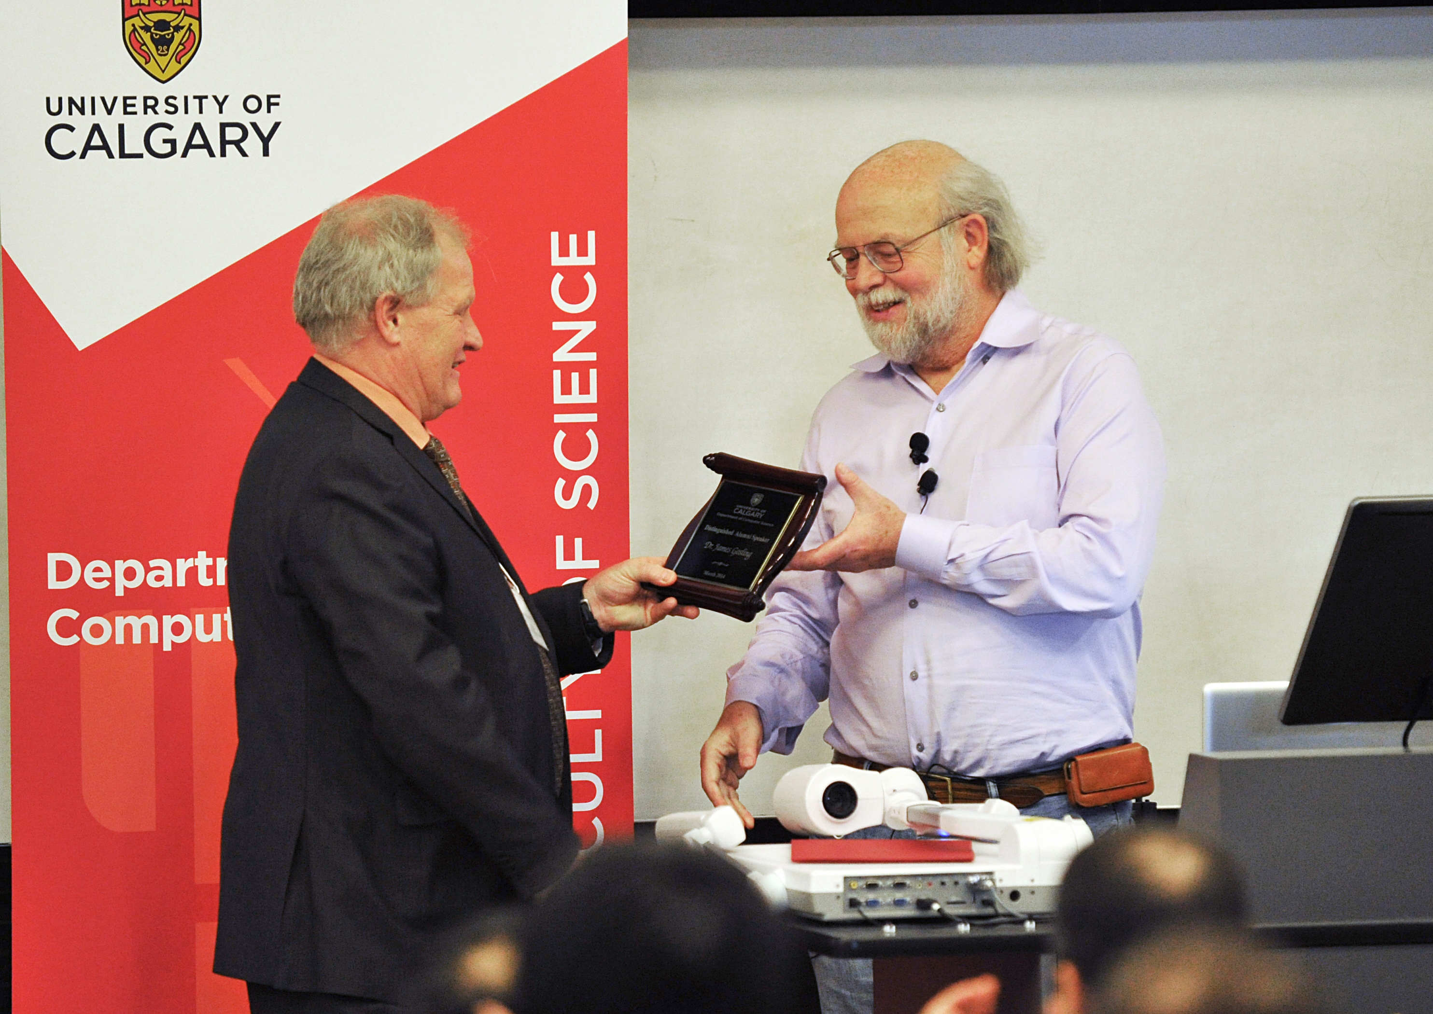
James Gosling – Founder of the Java Programming Language
He is one of us!
Bachelor of Science in Computer Science, University of Calgary
Snuck into CPSC labs at U of C while in William Aberhart High School (1973)
Notes:
James Gosling is a Canadian computer scientist and a UofC alumni known for his significant contributions to the world of computer programming and software development. Mostly he is known for his role in creating the Java programming language.

Slide 16
Operating Systems

Slide 17
Operating Systems
OS is the overarching software that
controls all the hardware on the computer
controls and manages all other software running on the computer
manages interactions with the user
Hardware
OS Software
User interaction
Application Software
Notes:
Everyday when we operate computers, we see how different hardware and software are operating and managed. That’s done by operating system.
OS is system software that serves as the core software component of a computer.
Its primary functions are to manage and control all the hardware resources of the computer and provide a foundation for running all software applications.
The modern operating systems like windows, macOS provide user interface that allows users to interact with the computers

Slide 18
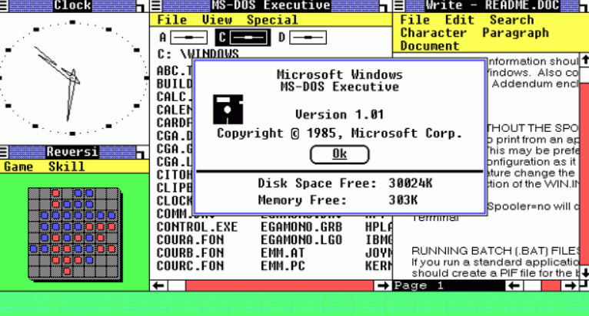
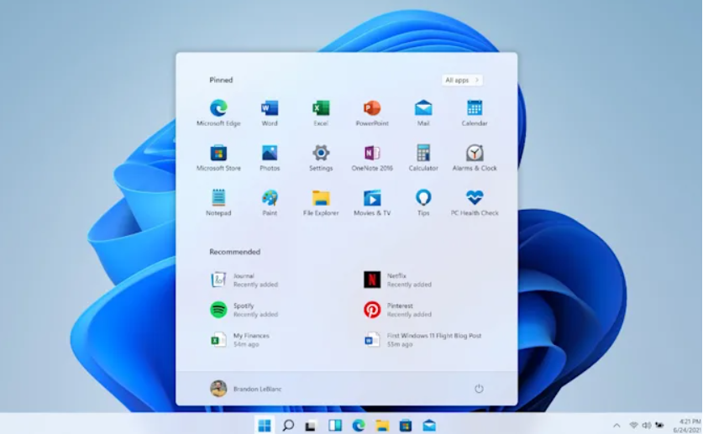
OS: Microsoft Windows
From Windows 1 to Windows 11

Slide 19
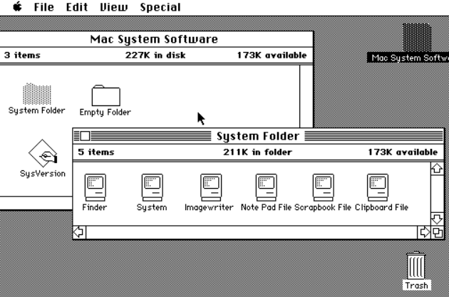
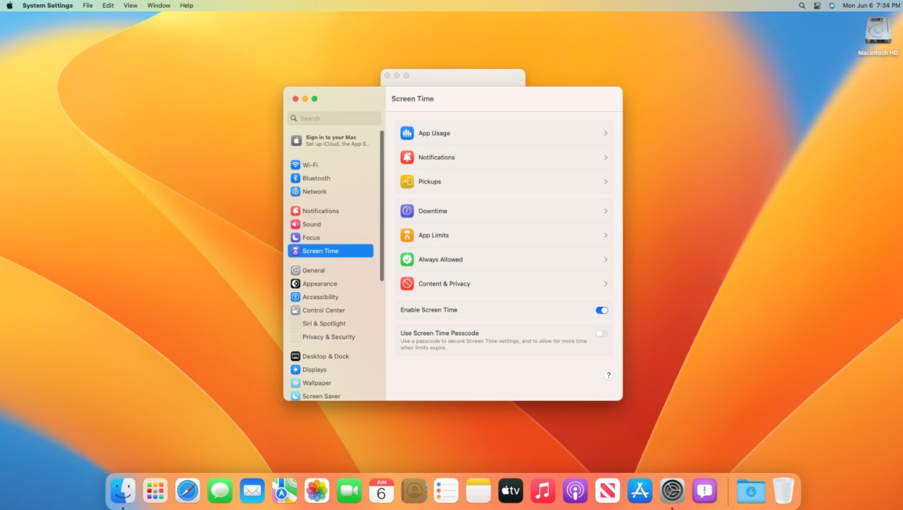
Apple Mac / OS X / macOS

Slide 20
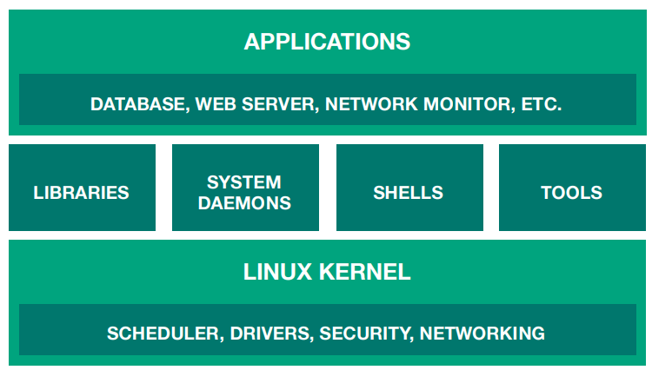
Linux
Free and open source software started by Linus Torvalds (1991), who also originally developed Git
Linus only built the Linux kernel (the core), but many other people contributed to the rest of the OS
Linux = Family of Unix-like OS with the Linux kernel
Android also uses the Linux kernel
Notes:
Linux is an open source OS kernel. Since its under an open source license, its sourcecode is freely available for anyone to view, modify, and distribute.
The term "kernel" refers to the core component of an operating system (OS). It is the central part of the OS that interacts directly with the computer's hardware and manages system resources. The kernel plays a crucial role in ensuring that software programs can run on the hardware smoothly.

Slide 21
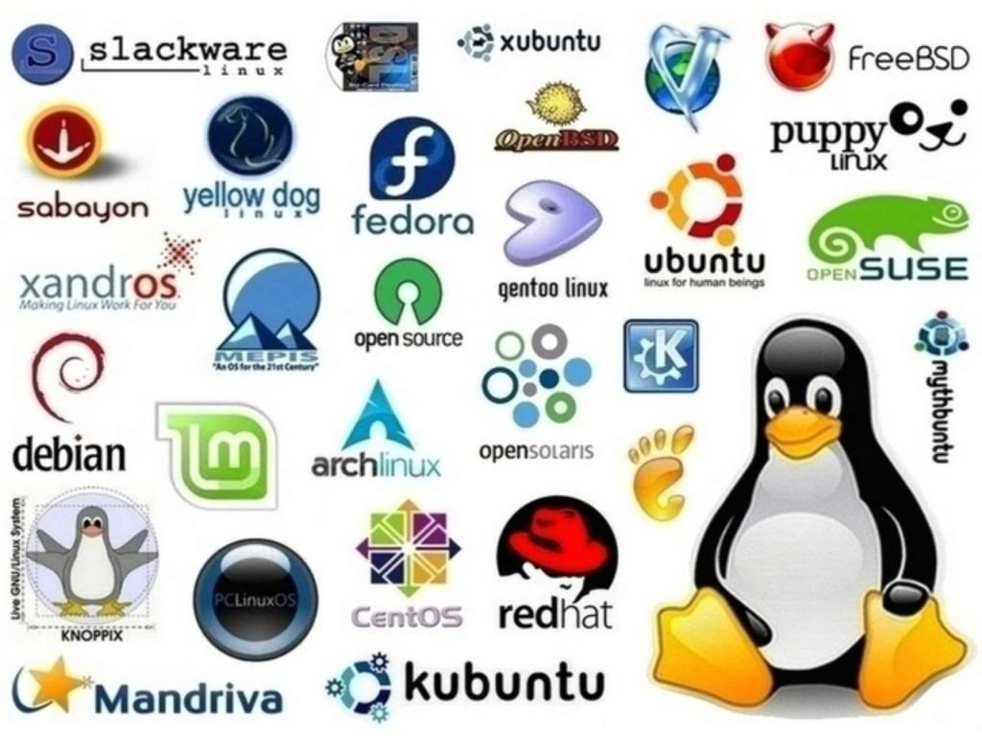
Linux
There is not just one “Linux OS”, but hundreds of them
Because it is free and open source, anyone can take it and make their own version (distribution)
This Photo by Unknown Author is licensed under CC BY-SA
Notes:
All the versions that we see now, such as Ubuntu, Fedora, etc. are various distributions of Linux OS

Slide 22
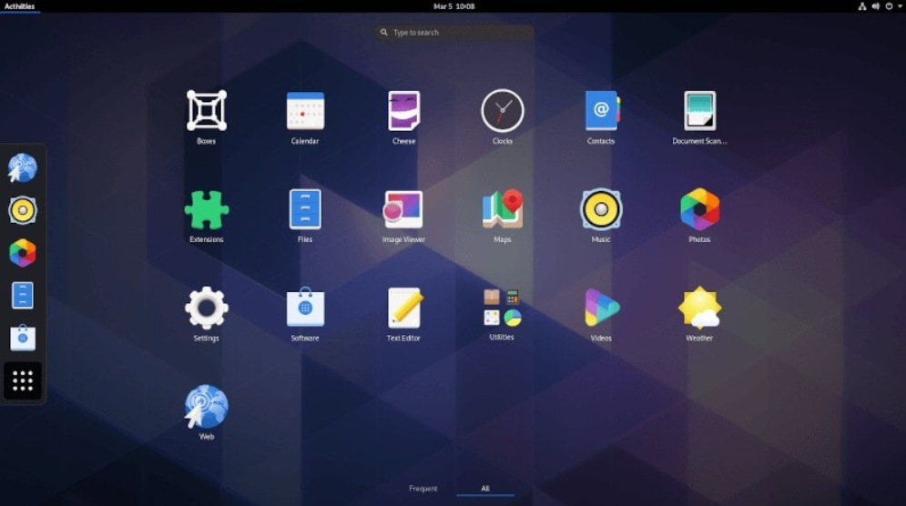
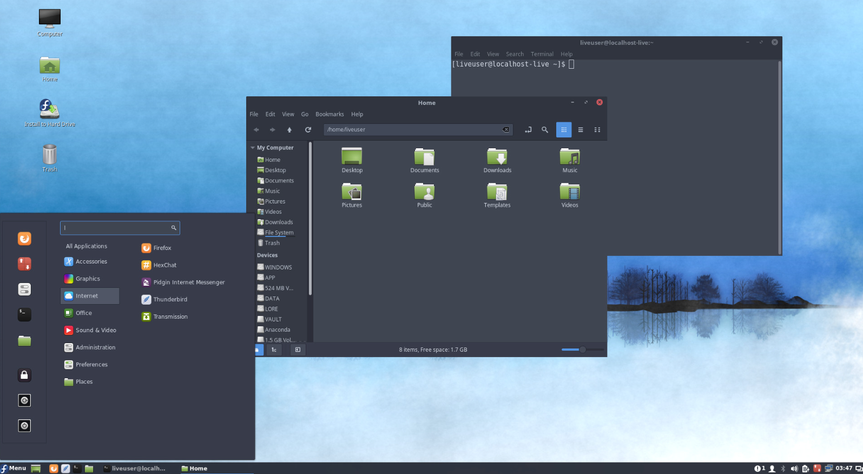
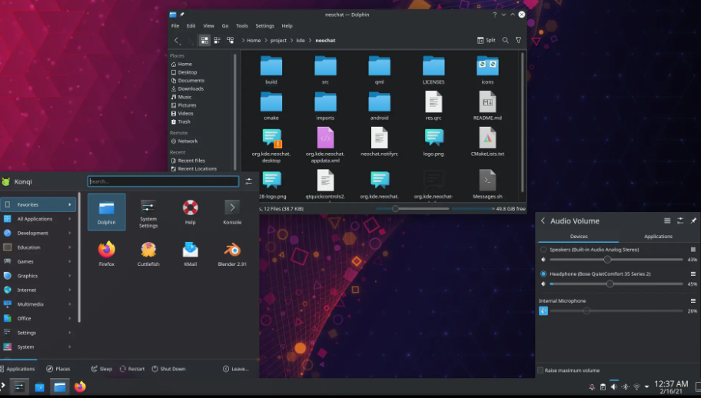
Linux
In addition, every Linux distribution can be customized using Desktop Environments giving it different apps and a different look and feel
Our computer lab
Linux distribution:
Fedora
Desktop Environment: Cinnamon

Slide 23
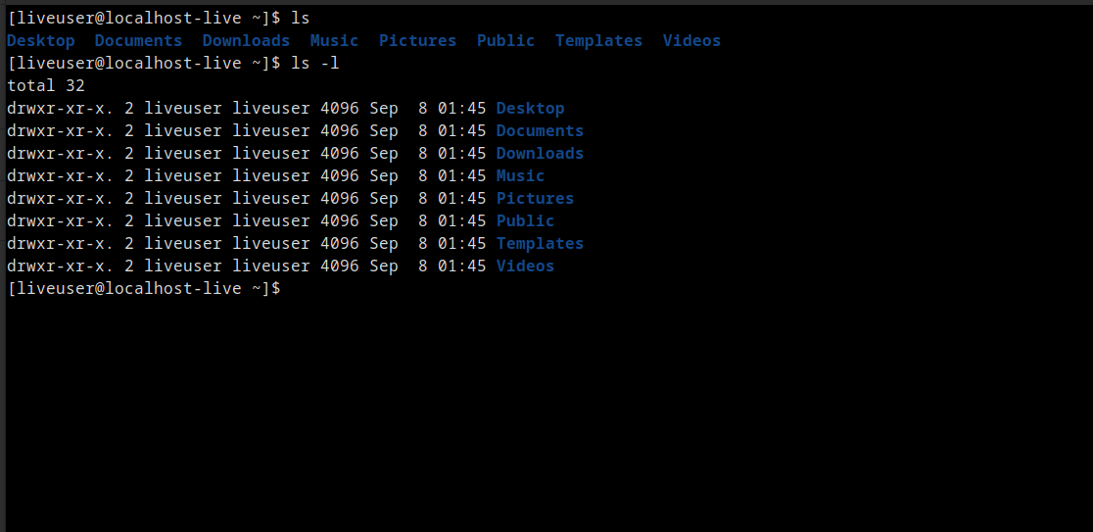
Linux file system
Regardless of how it looks, underneath the hood Linux is all the same
In fact, the Linux shell (terminal) is the original user interface
Any graphical desktop environment is only an “add-on” to the OS
Notes:
Different distributions of linux have different user interface. However, shell (terminal) is the original user interface for all

Slide 24
Credits
Content created and adapted for CPSC 231 by Jonathan Hudson and Richard Zhao.

